Slide 1

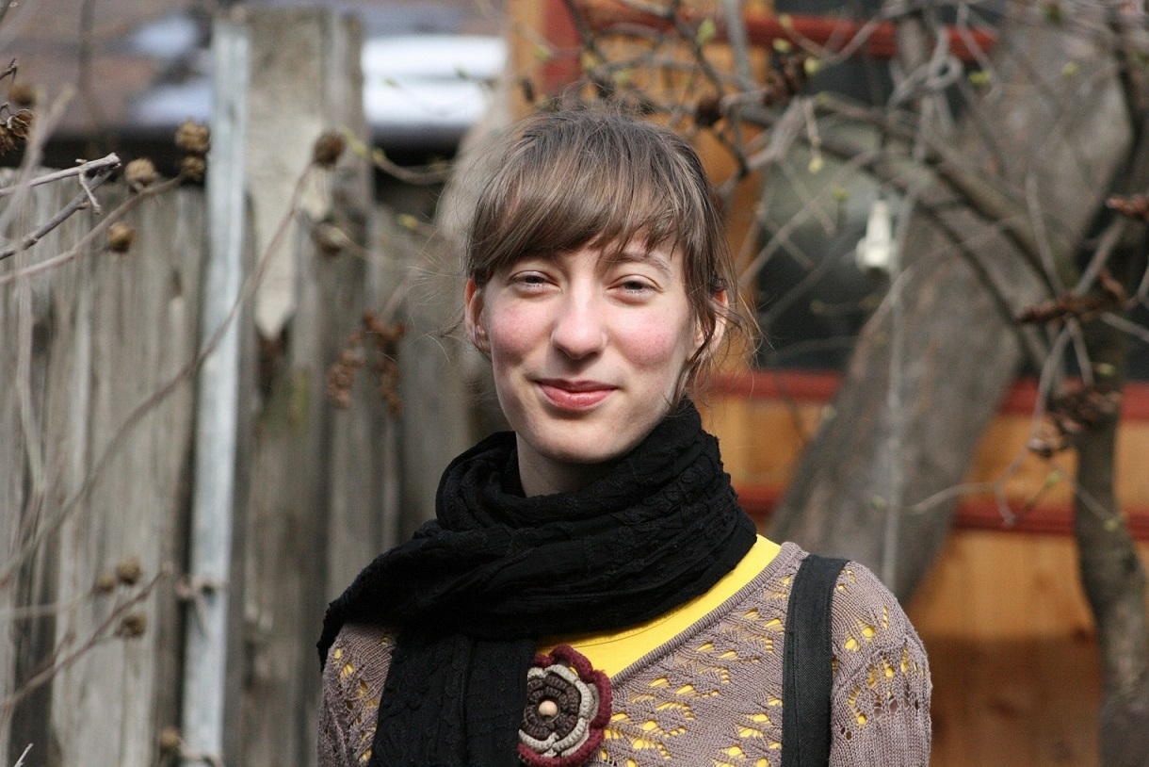


Alexandra Casapu, Altom www.altom.ro
Fooled by unknown unknowns
a success story
@esconfs
#esconfs

Slide 2
disclaimer
This story is based on true facts.
All events described herein actually happened.
All characters appearing in the story are non-fictitious.
Any resemblance to real persons, living or dead, is not purely coincidental, and should be apparent to them and the people who know them.

Slide 3
table of contents
my context in testing the Budgeting feature
my approach and analysis of it
after-the-fact reflections and observations

Slide 4
setting the scene
One day in October 2012...

Slide 5
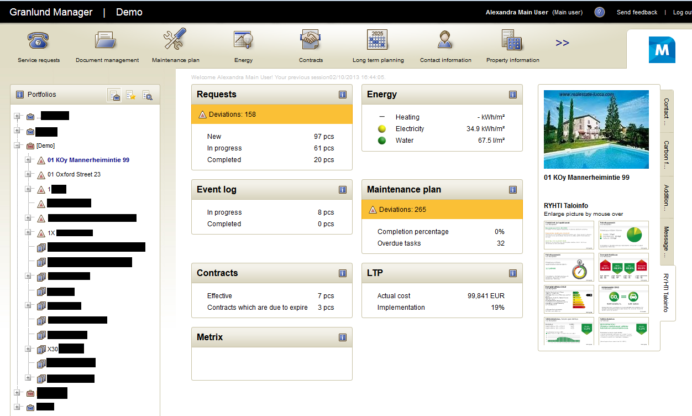

Slide 6
the characters
Maaret - software testing specialist with vast experience in testing and teaching
Kenneth - former project manager when Budgeting was first released in a different version
the developer from Russia - not working anymore on the project
Jenni - the business owner with contact to the customer

Slide 7
the project context
meetings? Nope
contact with Maaret
deliverables:
bug reports
reports in debriefings

Slide 8
the Budgeting area
developed 1 year ago by an external contractor
dev no longer available on the project
specification not updated since 1 year ago
preparing release for a client

Slide 9
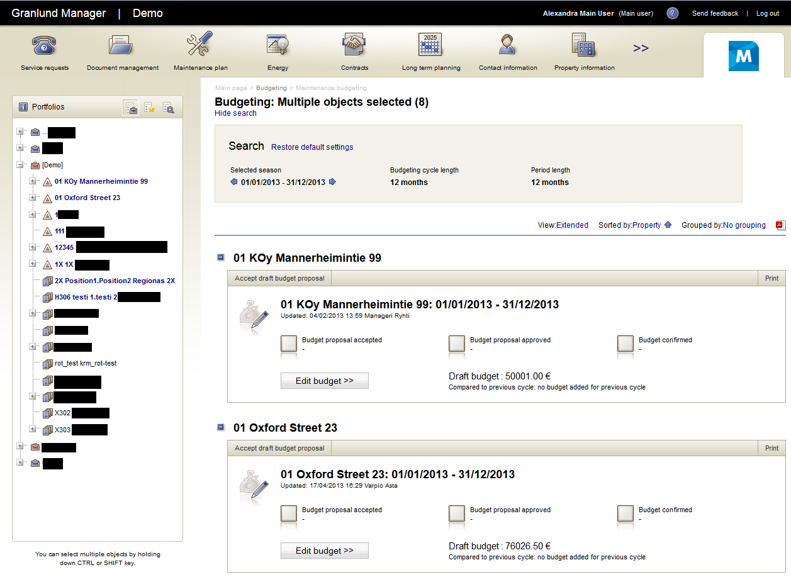

Slide 10
challenges
gaps in communication in the team
gaps in product and project knowledge
time constraints at the end of the testing round and lack of synchronization

Slide 11
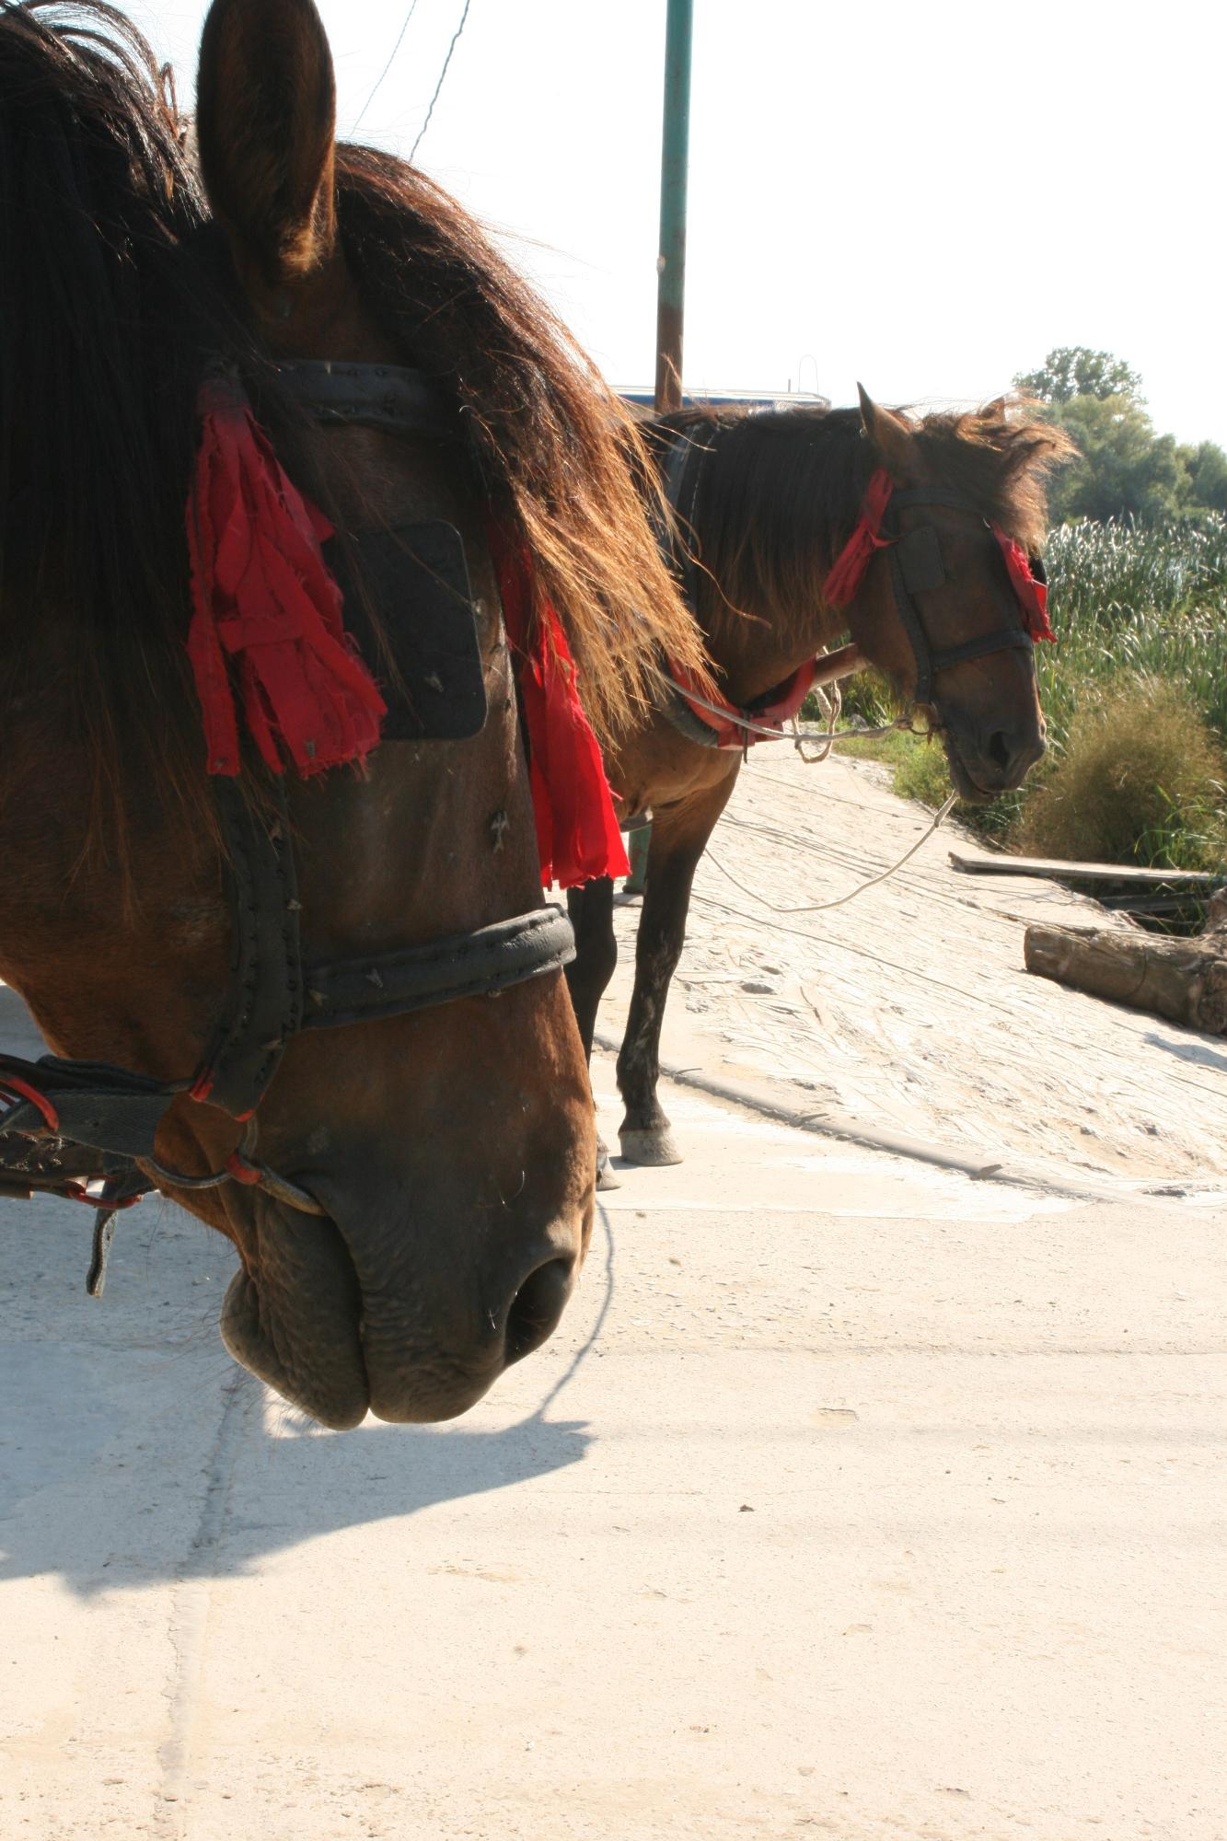

Slide 12
Kenneth
me Maaret Jenni
Customer

Slide 13
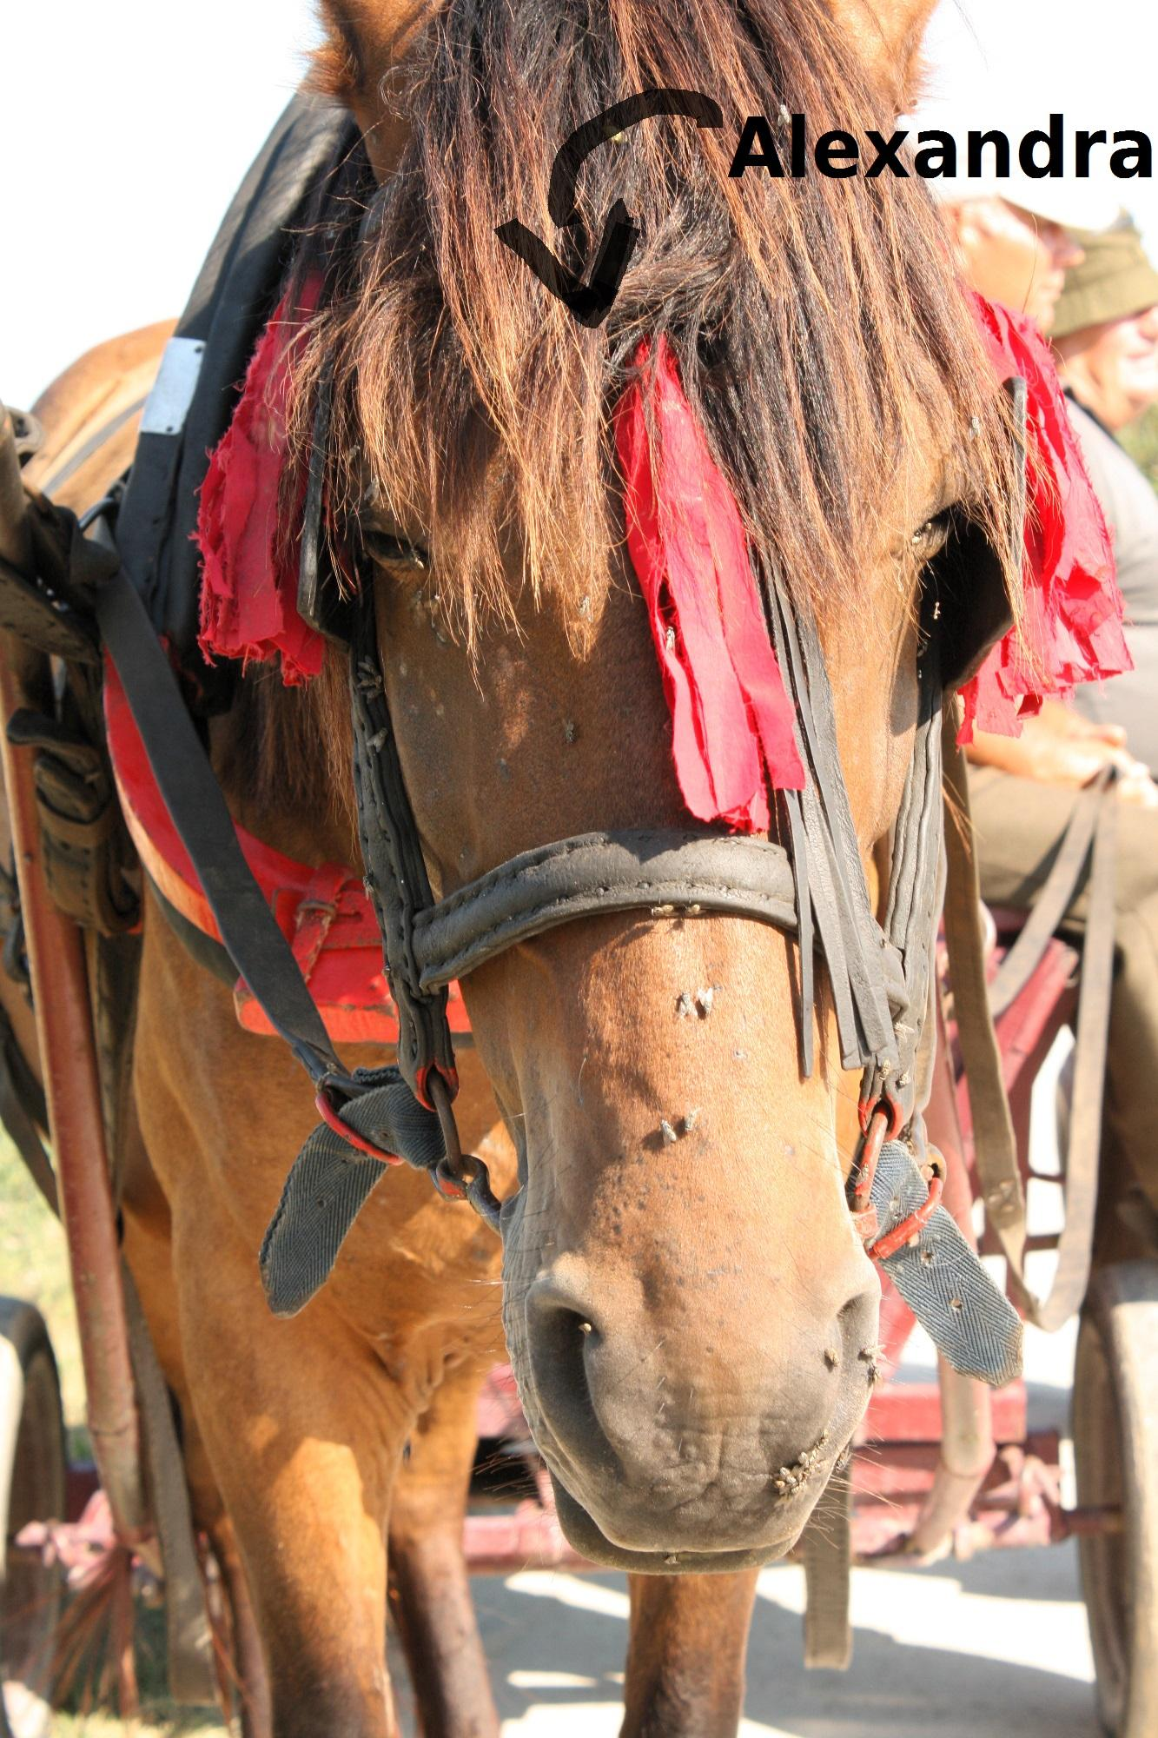

Slide 14
challenges
gaps in communication in the team
gaps in product and project knowledge
time constraints at the end of the testing round and lack of synchronization

Slide 15
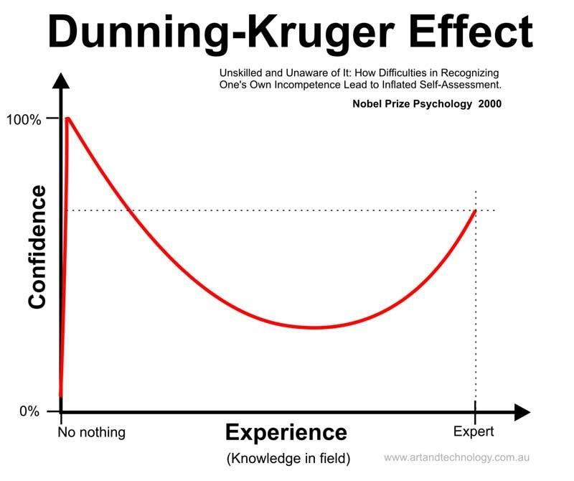

Slide 16
challenges
gaps in communication in the team
gaps in product and project knowledge
time constraints at the end of the testing round and lack of synchronization

Slide 17
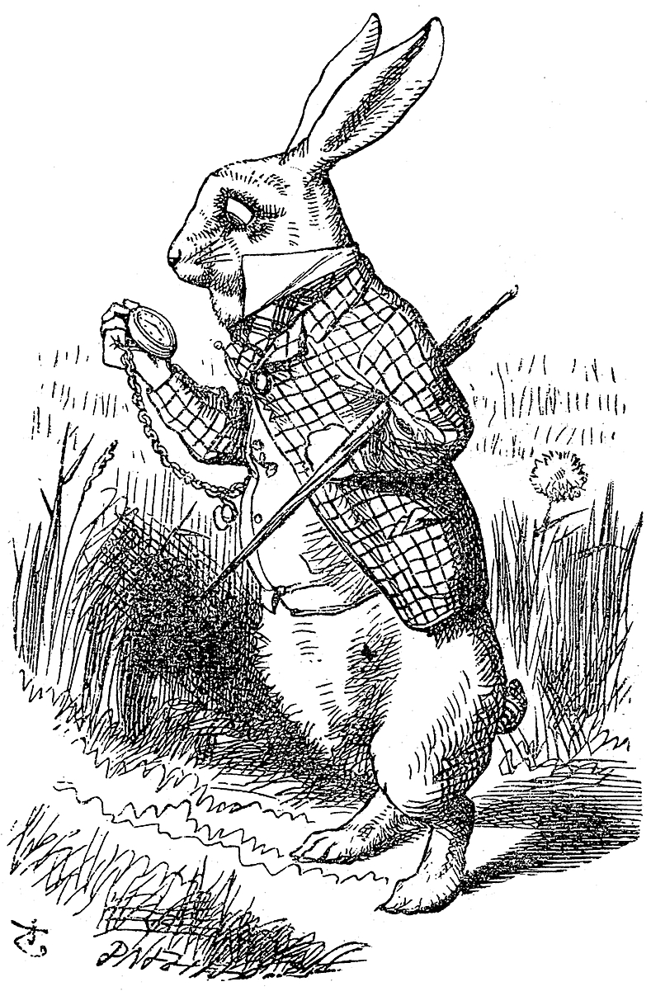

Slide 18
resources
the spec + a contact person
feedback from Maaret
personal judgement
bug taxonomies, cheatsheets (http://testobsessed.com/wp-content/uploads/2011/04/testheuristicscheatsheetv1.pdf)

Slide 19
what I didn’t know I didn’t know
stuff I ignored
questions not asked
awareness over what I’m focusing on

Slide 20
ignored
make tests using all the client DB that was available at some point
change of context: the dev was not speaking Finnish

Slide 21
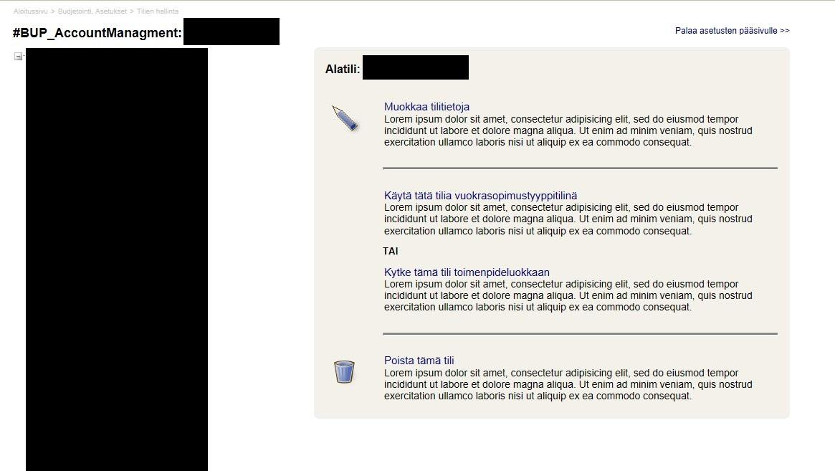

Slide 22
unquestioned
what 'significant' means to others
what is different between my feature and a similar one
what is NOT covered if I test from this perspective

Slide 23

The rabbit hole

Slide 24
into the rabbit hole
focusing on money related stuff, like calculations
money -> numbers -> calculations

Slide 25
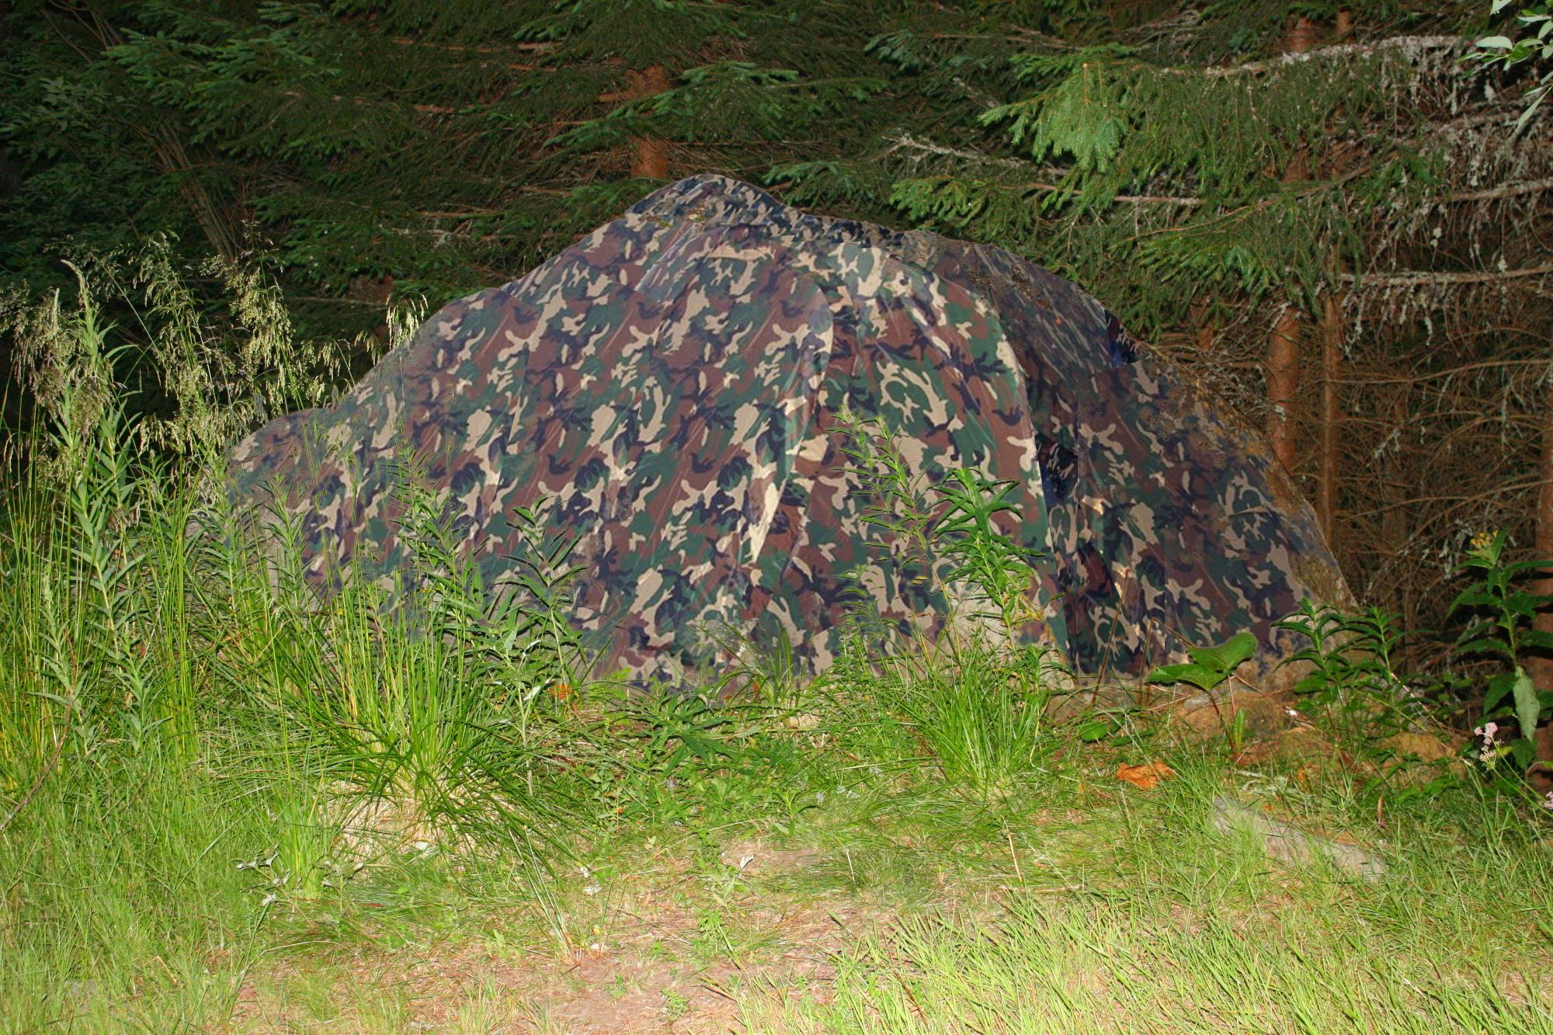

Slide 26
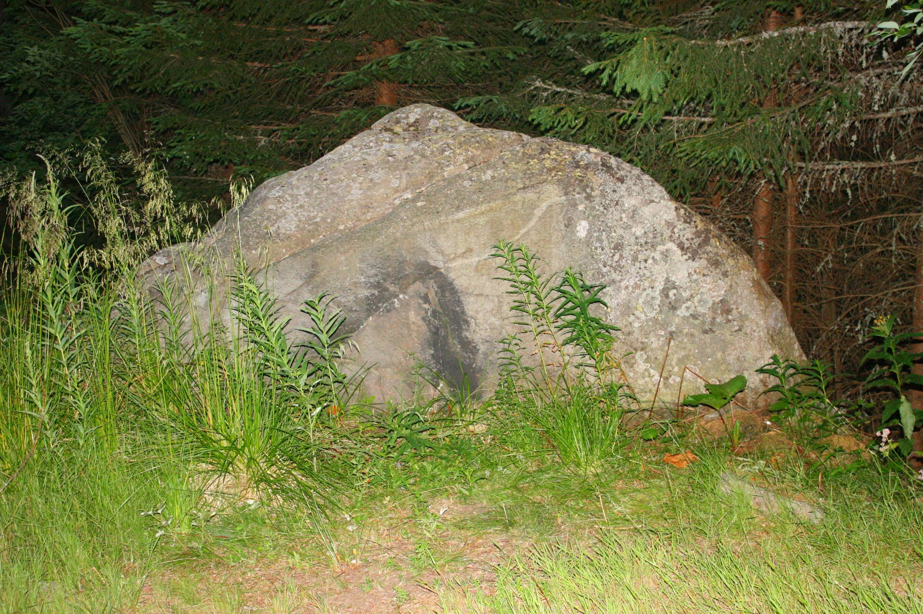

Slide 27
into the rabbit hole
compare, rather than contrast the functionality with others in the app

Slide 28
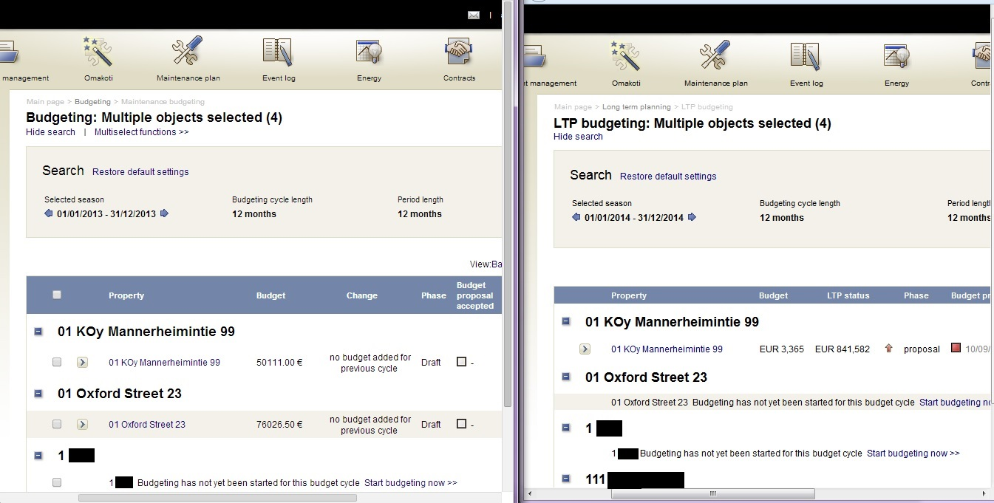

Slide 29
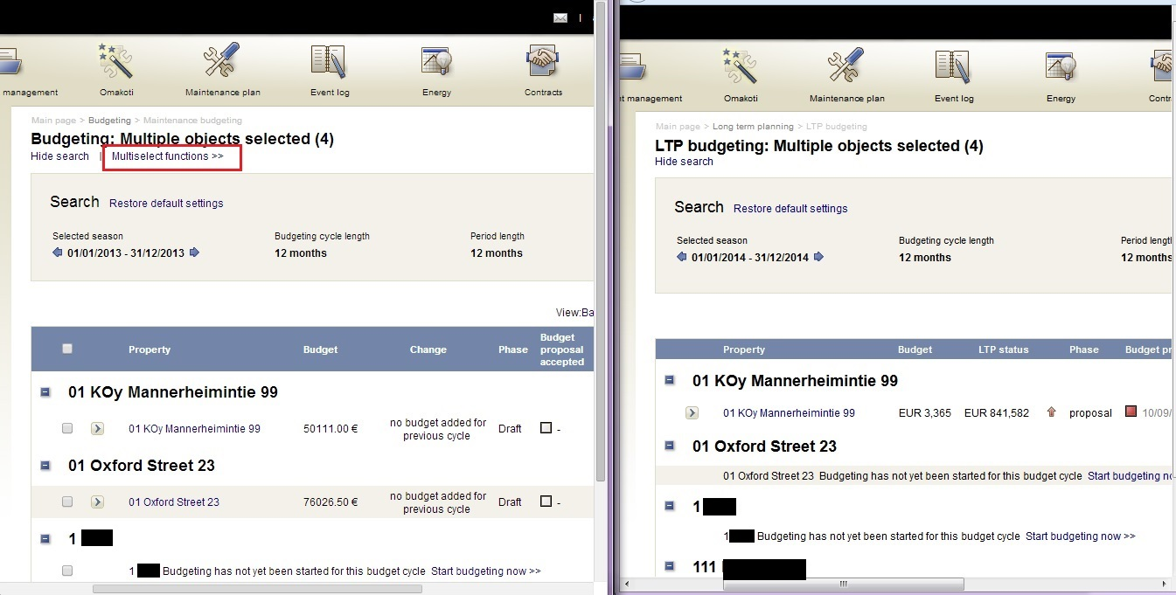

Slide 30
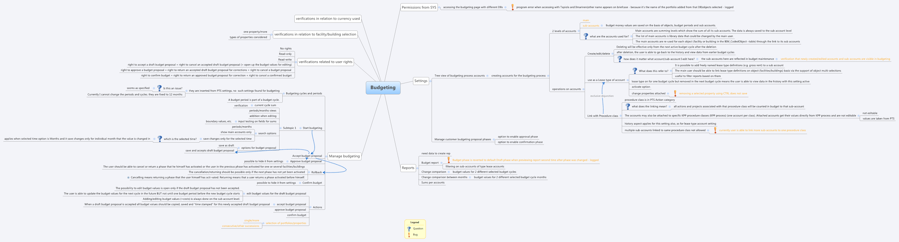
into the rabbit hole
relate to a mindmap I created, rather than returning to the actual specification

Slide 31
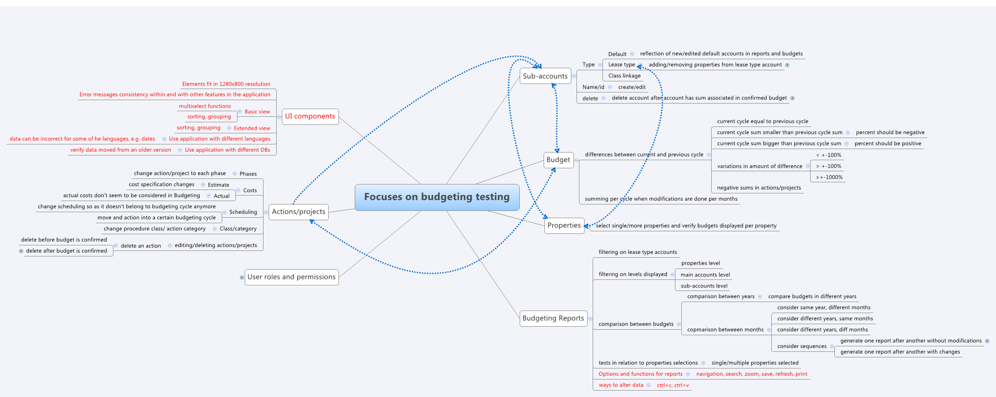
into the rabbit hole
focus on elaborate flows rather than simple ones

Slide 32
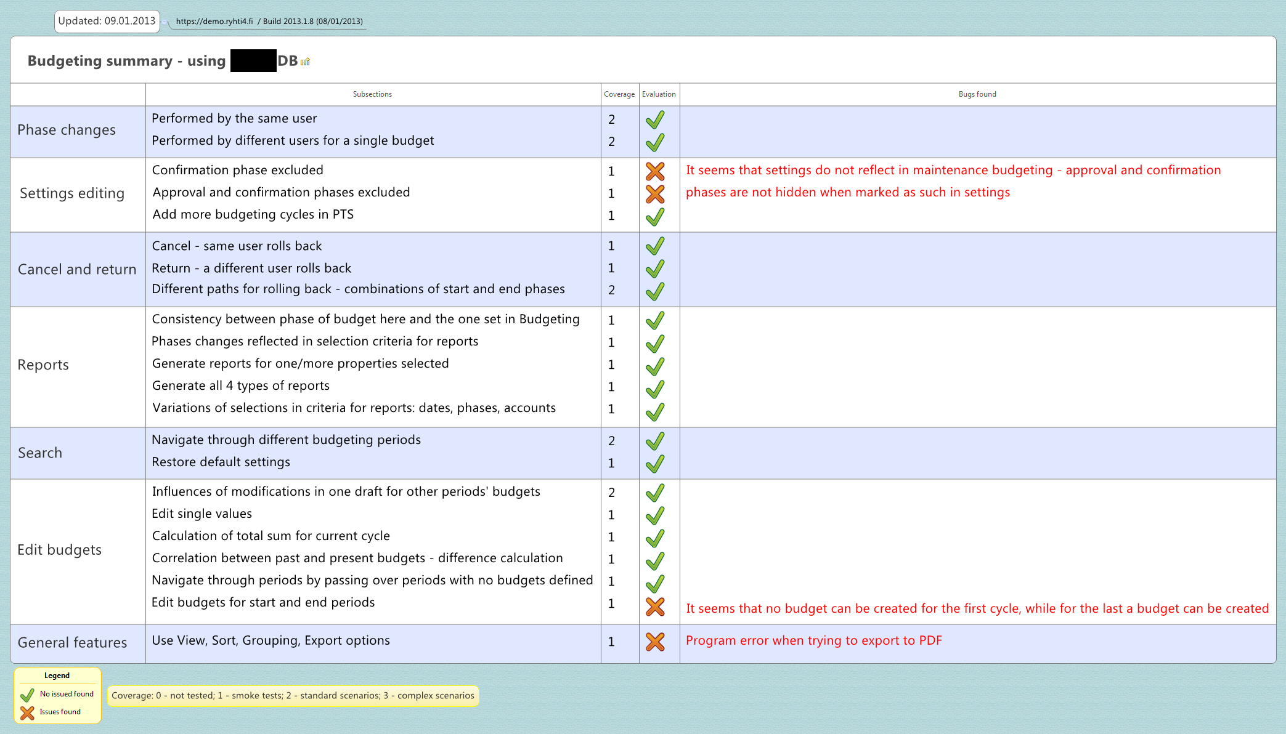
into the rabbit hole
focus on reporting on what has been covered, and not on what has been left out

Slide 33
a twist!
The debriefing session with Maaret

Slide 34
[23.01.2013 18:51:18] Maaret: This sorting thing is something we've fixed on other processes even as branch fixes, it seems to annoy relevant customers

Slide 35
[28.12.2012 16:07:36] Alexandra: What is specific to the X DB?
[28.12.2012 16:08:05] Maaret: It's huge and it's been created with version 3 where there is budgeting feature

Slide 36
[23.01.2013 19:15:21] Alexandra: […] I thought X only started using budgeting recently
[23.01.2013 19:16:01] Maaret: They've used budgeting for many many years in version 3.
[23.01.2013 19:16:11] Maaret: And have started using version 4 only recently
[23.01.2013 19:16:28] Maaret: The whole spec comes from "let's create budgeting as it was in version 3"
[23.01.2013 19:16:37] Alexandra: Oh, I see..

Slide 37
I found many new issues from that moment on
5 issues before our discussion
29 after

Slide 38
another twist
the management decision for deployment had
already been taken
14 issues still not solved up until today

Slide 39
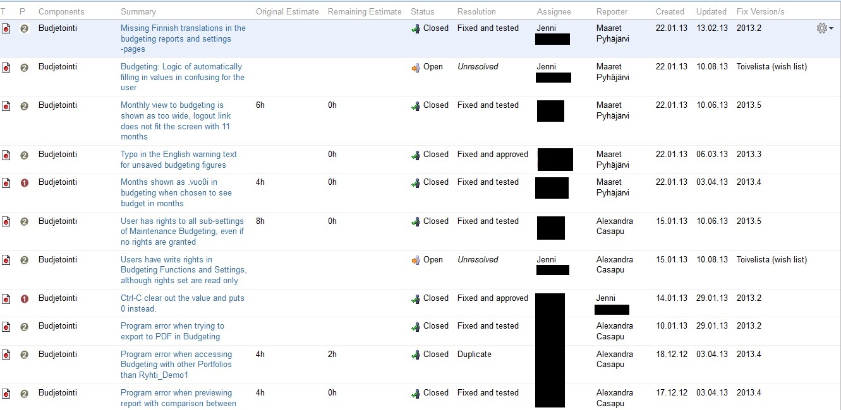

Slide 40
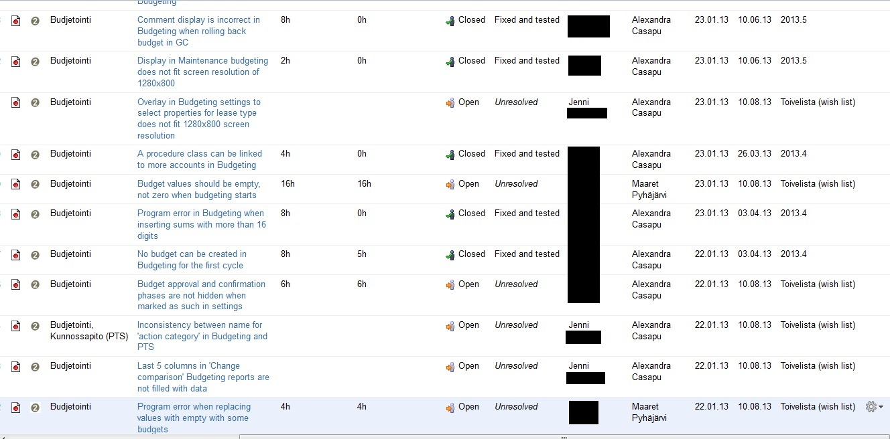

Slide 41

Transforming lessons

Slide 42
lessons learned
strive for communication and collaboration
make sure we synchronize
collaboration is very useful when testing

Slide 43
lessons learned
I’m not done when that thought first pops in
when I think ‘I’m done’, think about how I could invalidate this statement
when I report, focus also and reflect on what I haven’t covered, what I could have missed

Slide 44
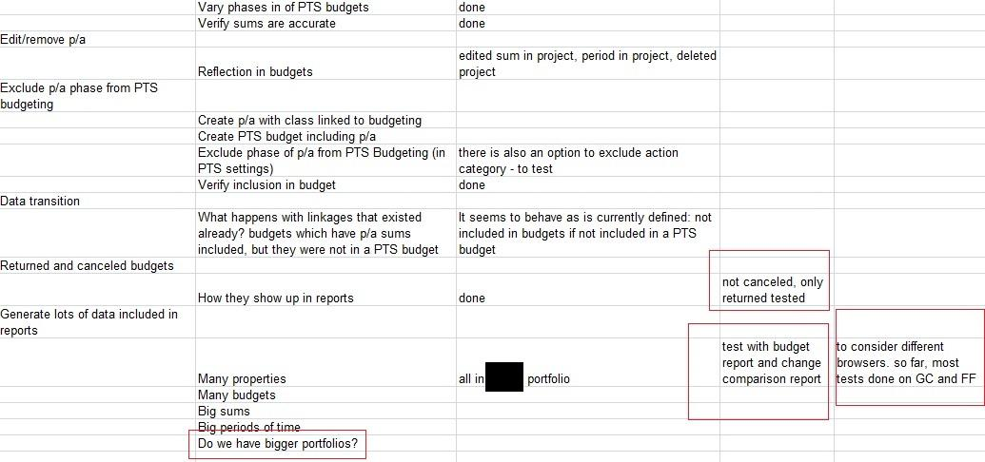

Slide 45
lessons learned
give myself the chance to recognize patterns
read other/incoming bugs on the project to understand what could be relevant
put relevant stuff into appropriate categories in mindmaps – don’t expect to just remember everything

Slide 46
Thank you for listening to the story
alexandra.casapu@altom.ro
@coveredincloth

Slide 47

Time for questions!

Slide 48
references
“100 Things Every Designer Needs to Know About People” - Susan Weinschenk
‘The Black Swan’ - Nassim Taleb
http://en.wikipedia.org/wiki/All_persons_fictitious_disclaimer
http://attentioninteractive.com/2013/03/21/dunning-kruger-effect/
http://en.wikipedia.org/wiki/File:The_black_swan_taleb_cover.jpg

